Slide 1







Analyze of Technology Trends
Mehmet Cahit Aydın
13/10/2021

Slide 2



OUTLINE
Executive Summary
Introduction
Methodology
Results
Visualization – Charts
Dashboard
Discussion
Findings & Implications
Conclusion
Appendix

Slide 3

EXECUTIVE SUMMARY
Current Technology Usage Trend
Language
Database
Platform
Web Frame
Future Technology Trend
Language
Database
Platform
Web Frame
Demographic Survey
Country & Gender Analysis

Slide 4

INTRODUCTION
The purpose of this analysis is to show current and future technology tools for software developers or people who want to improve themselves in this field.
Many people want to improve themselves both for the profession they have and for the profession they want to have in the future.
In order to respond to these needs, various surveys, websites and APIs were used.
Result of Analyzes ,
Top Programming Languages,
Databases,
Platforms and Web Frames are defined.

Slide 5

METHODOLOGY
Data Collection
Collecting Data Using APIs
Collecting Data Using Web Scraping
Data Wrangling
Data Exploration
Data Visualization
Matplotlib & Seaborn
IBM Cognos Dashboard
Presentation

Slide 6
RESULTS

Slide 7
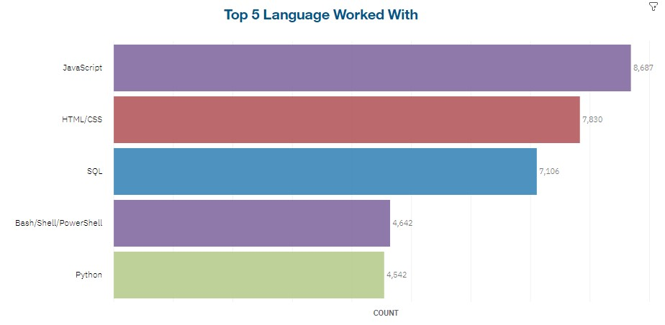
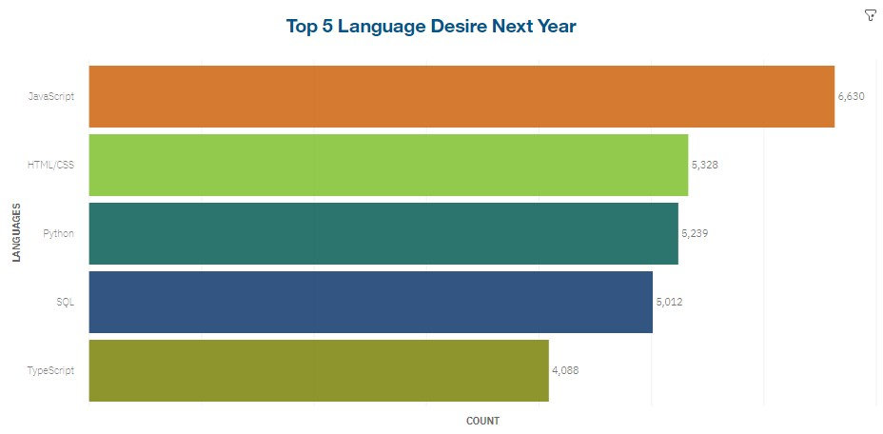
PROGRAMMING LANGUAGE TRENDS
Current Year
Next Year

Slide 8
PROGRAMMING LANGUAGE TRENDS - FINDINGS & IMPLICATIONS
Findings
JavaScript is top trending language in the world
Python and TypeScript are becoming more popular
HTML/CSS and SQL will continue to be popular now and in the future.
Implications
Web development and Web developers will continue to be in high demand
There will be a need for more programmers who know Python and TypeScript languages.
The number of seniors who know HTML/CSS and SQL will increase.

Slide 9
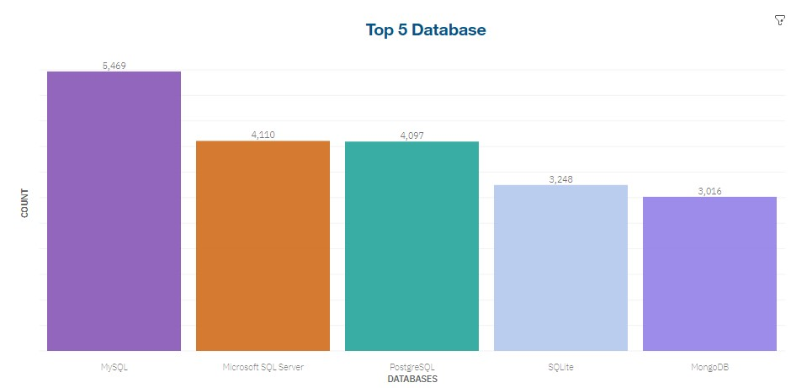
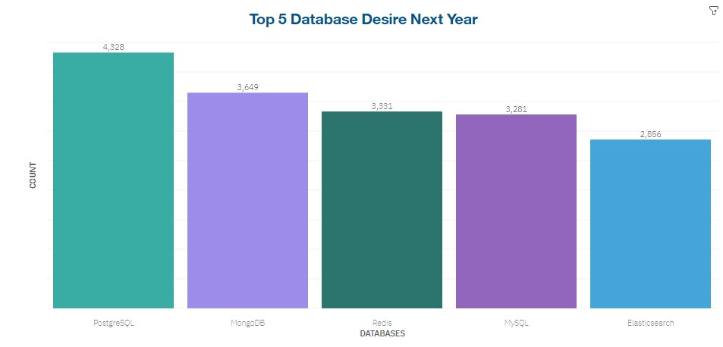
DATABASE TRENDS
Current Year
Next Year

Slide 10
DATABASE TRENDS - FINDINGS & IMPLICATIONS
Findings
PostgreSQL and MongoDB are the most wanted databases to learn.
MySQL is the most popular database.
Microsoft SQL Server still retains its charm.
Implications
NOSQL databases will take a huge leap forward in the future.
OpenSource and web platforms will continue to use MySQL.
Microsoft SQL Server continues to lose popularity.

Slide 11

DASHBOARD
DASHBOARD LINK
TECHNOLOGY TRENDS DASHBOARD

Slide 12
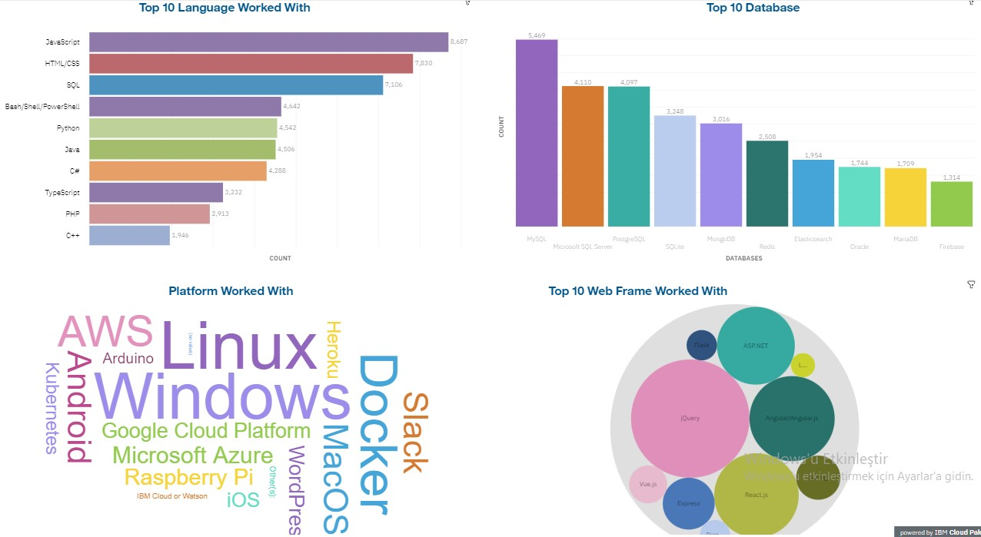
CURRENT TECHNOLOGY USAGE

Slide 13
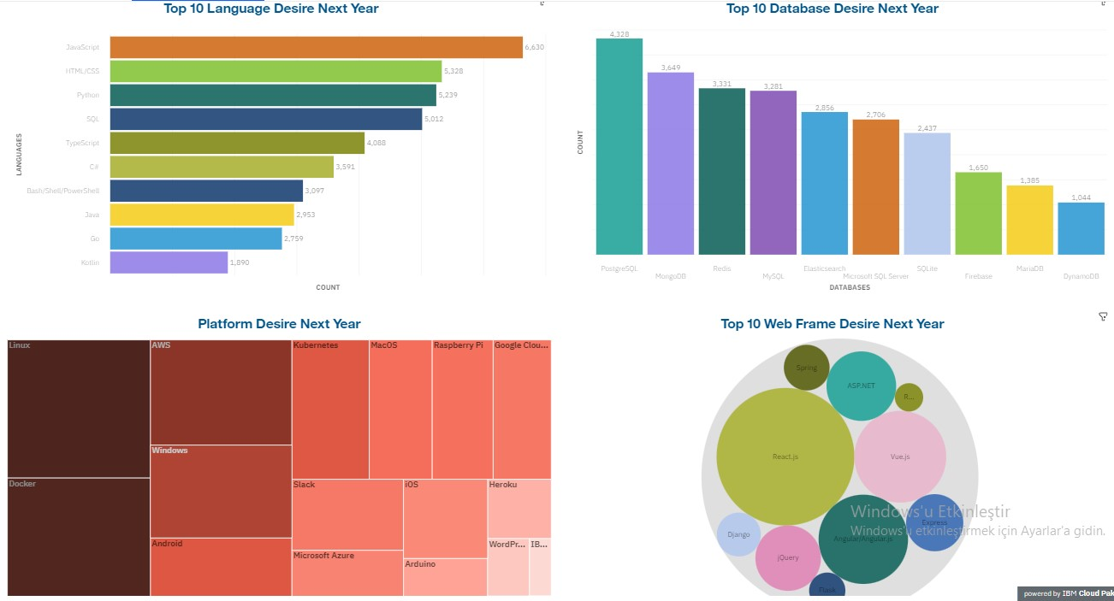
FUTURE TECHNOLOGY TREND

Slide 14
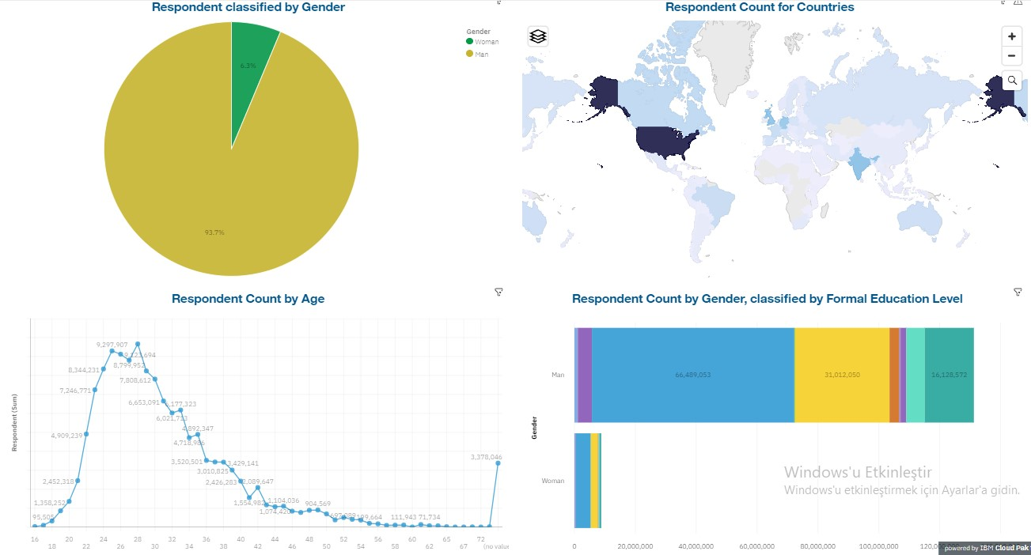
DEMOGRAPHIC SURVEY

Slide 15
DISCUSSION
According to these analyzes, will the technologies that are in demand in the future consist of only these?
or
Will these technologies be insufficient?

Slide 16
OVERALL FINDINGS & IMPLICATIONS
Findings
USA is the top technology country.
The number of women software developers is very low compared to men.
Linux , AWS and Docker are the most demanded platforms.
Technology tools are constantly changing.
Implications
In more different countries, they should join the technology network and develop themselves.
The inequality between female and male software developers should be resolved. More female software developers should enter the sector.
Software developers have to constantly follow the changing technology.

Slide 17

CONCLUSION
Programming Languages, Databases , Platforms and Web Frame Trends are changing and developing day by day.
Other countries, except the USA, continue to lag behind in technology.
Women are very lacking in participation in technology.
There is no relationship between the salary demanded by the software language and the software language desired to be learned.
In line with big data, NoSQL databases and data processing languages such as Python are in high demand.

Slide 18
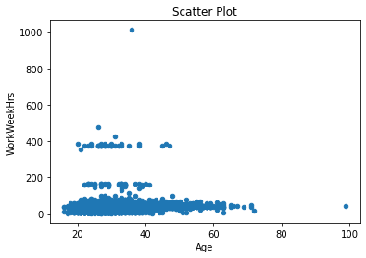

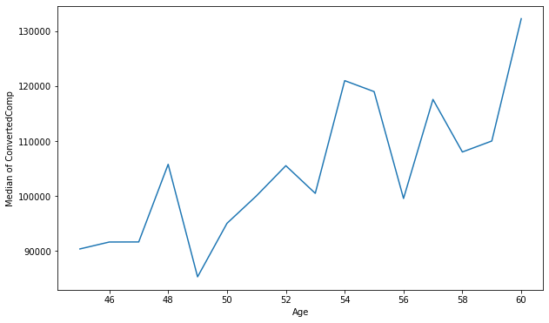
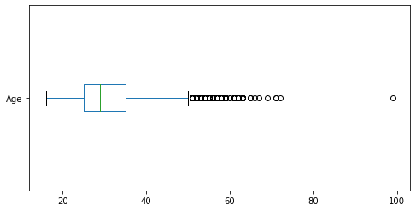
APPENDIX
Searching for Correlations Between
Age and WorkWeekHrs
Line Chart of Salary for 45 To 60 Year Olds
A Boxplot To Find The Outliers

Slide 19
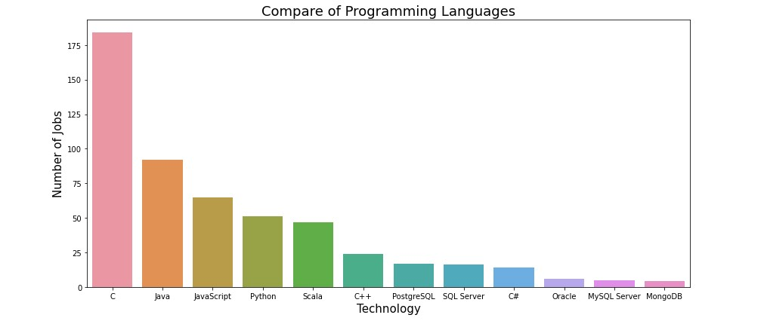
GITHUB JOB POSTINGS

Slide 20
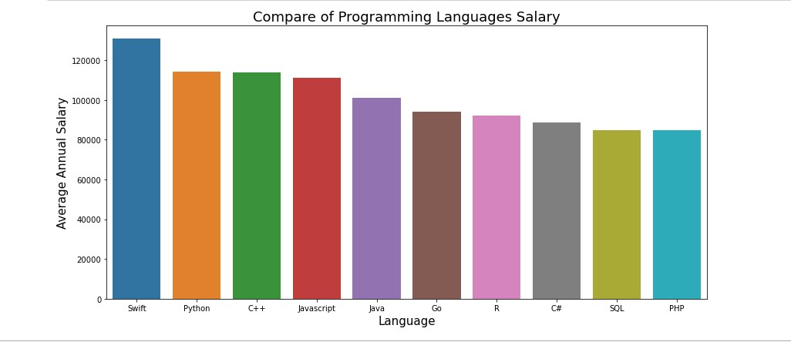
POPULAR LANGUAGES

